Slide 1
Nonresident Alien Tax Compliance
Wednesday, February 22, 2017
Lisa Hall

Slide 2
Agenda
Overview of the Tax System
Federal Income Taxes
State Income Taxes
Social Security/Medicare Taxes
Processing Procedures for Payments
Taxation of Payments
Treaty Benefits
Best Practices
Questions
Resources

Slide 3
Overview of the Tax System
System Residency Status
U.S. Tax System U.S. Citizens
Lawful Permanent
Residents
Resident Alien for Tax
Purposes
Nonresident Alien Tax Nonresident Alien for Tax
System Purposes

Slide 4
Federal Income Taxes
General Rule
Must withhold federal income tax from all income payments
made to or on behalf of a nonresident alien
Withhold at 30% unless
An exception is available (14% for nonqualified scholarships,
wage withholding, treaty) and
The requirements for the exception are met
If the withholding agent does not withhold the appropriate
amount of tax at the time of payment, the withholding agent will
be liable for the tax, plus any penalties and interest – regardless of whether the individual pays the tax on his or her tax return

Slide 5
State Income Taxes
North Carolina 4% Withholding
Services performed by ITIN holders
Non-Resident Contractors
Non-wage compensation
Paid to a nonresident contractor
Greater than $1,500 during the calendar year
For personal services performed in NC
a performance
an entertainment or athletic event
a speech or
the creation of a film, radio, or television program

Slide 6
State Income Taxes
North Carolina 4% Withholding
Withholding must be rounded to the next whole dollar
Corporations or LLCs with a permanent place of business in NC can obtain an NC Certificate of Authority and submit it during the payment process
Not applied retroactively
If paid $1,000 in January and $600 in July, you would only withhold on the payment made in July

Slide 7
Social Security/Medicare Taxes
Applies to compensation for employment services
Exceptions:
Student FICA Exception
Students working on the campus of the institution where
they are enrolled and regularly attending classes
Same rules for US citizens
NRA FICA Exception
Nonresident aliens
In F-1, J-1, M-1, or Q-1/Q-2 status
Engaged in employment consistent with the
purpose of the visit
Totalization Agreement Exception with a certificate of coverage

Slide 8
Processing Procedures for Payments
Step 1: Complete Vendor Setup Forms
Step 2: Determine Type of Payment
Step 3: Complete Payment Paperwork

Slide 9
Step 1: Complete Vendor Setup Forms
Payments to Foreign Persons
Vendor Information Form (Form W-8BEN)
Foreign National Information Form (FNIF)
Non-student or Student Version
Copies of immigration documents may be necessary
Payments to Foreign Businesses
Form W-8BEN-E
http://finance.uncc.edu/resources/forms

Slide 10
Step 2: Determine Type of Payment
Types of Payments
Compensation for services
Dependent personal services: wages, salary, stipend, service-related payments, travel reimbursements
Independent personal services: consulting fees, guest speaker, honorarium, travel reimbursements
Scholarships
Tuition and fees
Room and board
Book Allowances
Parking
Travel Award
Other Income
Gifts, prizes and awards

Slide 11
Step 2: Determine Type of Payment
Misclassification can lead to incorrect withholding of taxes and incorrect reporting of payment
The name given to the payment by the payer
is not controlling
Examples:
A scholarship requiring services to be performed
is compensation
A stipend may be either a scholarship or compensation

Slide 12
Step 3: Complete Payment Paperwork
Compensation
Dependent
Wages / Salary / Stipend
Human Resource/Academic Affairs Forms
Travel Reimbursement / Payment
Travel Authorization and Travel Reimbursement
(TA and TR)
Independent
Ind Per Services / Consulting Fee / Honorarium / Guest Speaker Fees
Direct Pay Request (DPR)
Travel Reimbursement / Payment
Non-employee TA and TR / DPR

Slide 13
Processing Procedures for Payments Step 3: Complete Payment Paperwork
Scholarships to Non-US Citizens
Student Educational Award System (SEA)
Grants and Contracts Administration website
Part of Image Now
Gifts, Prizes and Awards
Direct Pay Request (DPR) and
Policy 101.18, Appendix B – Reportable Gifts, Awards and Prizes Form

Slide 14
Taxation of Payments General Rule: Taxable unless an exclusion exists
Compensation to Non-US Citizens
Dependent
Wages / Salary Taxable
Travel Reimbursement / Payment “Accountable Plan”
Independent
Ind Per Services / Consulting Fees Taxable (30%)
Honorarium / Guest Speaker Fees Taxable (30%)
Travel Reimbursement / Payment “Accountable Plan”
Other Taxable (30%)
Scholarships to Non-US Citizens
Tuition / Fees Excluded under Section 117
Room / Board Taxable (14%)
Book Allowances Excluded under Section 117
Travel Award Taxable (14%)
Prizes and Awards to Non-US Citizens Taxable (30%)

Slide 15
Are travel expenses taxable?
The “Accountable Plan” rules only apply when there is
a business purpose
Employees and Independent Contractors who
receive compensation
The “Accountable Plan” rules do not apply if there is
not a business purpose
Students and scholars who receive non-service
scholarships or fellowships

Slide 16
Honorarium Payments
9-5-6 Rule
Covered aliens on a temporary visit may accept an
honorarium payment for usual academic activity
lasting not longer than 9 days at any single institution,
and
If the alien has not accepted such payment from more
than 5 institutions
In the previous 6-month period
Covered aliens: B-1, B-2, VWB, VWT, aliens from Canada
and aliens with valid border-crossing card

Slide 17
Gross-up Option
Increase of gross payment due to recipient to cover any taxes withheld so the individual receives the desired net amount
Must use non-allocated funds
Check option for this on Direct Pay Request
NC 4% withholding
Nonresident alien withholding
Complete Gross-up Calculation form for employees
17

Slide 18
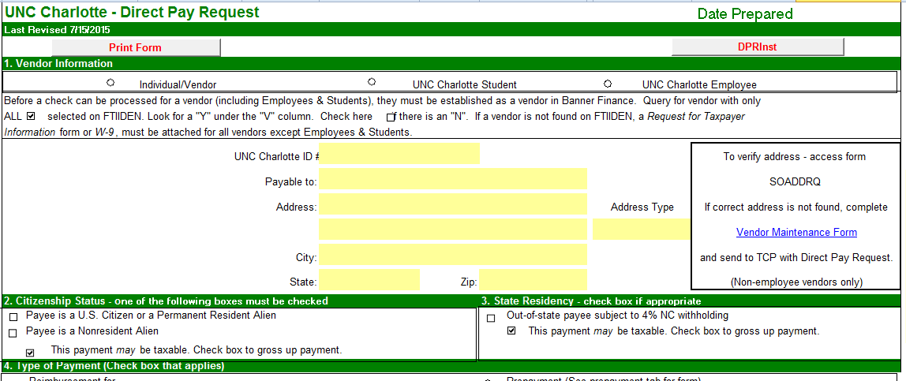
Gross-up
Check gross up checkbox on DPR form
18

Slide 19
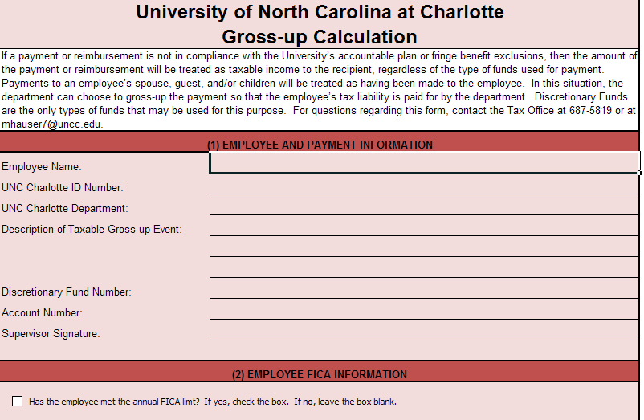
Gross-up
Complete form

Slide 20
Tax Treaty Benefits
The US has tax treaties with over 60 countries
Treaties offer tax exemptions for foreign nationals
who were or are tax residents (not citizens) of a
treaty country and meet specific criteria as defined
by the treaty
Many foreign nationals understand and expect
these benefits
Treaty benefit eligibility will be determined from a review of the
completed Foreign National Information Form and W8BEN.

Slide 21
Best Practices
As soon as you know you will have a foreign visitor,
start the paperwork
Don’t start paperwork after the visitor has performed services
or you risk not being able to pay the visitor
All payments (except wages and scholarships) to nonresident aliens should be processed on a DPR
All travel guidelines and requirements apply to foreign visitors
Accountable plan (nontaxable)
Use this for travel portion of trip to make less of the payment taxable
Keep the gross-up option in mind
NRA rules and regulations are mandated by the IRS, NC Department
of Revenue, US Immigration Services, and US Department of
Homeland Security
Let visitors know we have a Tax Office that would be happy to discuss the tax
implications of their payments with them
When in doubt, call or email the Tax Office

Slide 22
Questions?

Slide 23
Resources
Tax Office Website:
http://finance.uncc.edu/about-us/controllers-office/tax-office
IRS Publications
15T, Employer’s Tax Guide
515, Withholding on Nonresident Aliens and
Foreign Entities
519, US Tax Guide for Aliens

Slide 24
Contacts
Robyn Diehm
Assistant Controller - Tax & Payroll
(704) 687-5819
bdiehm1@uncc.edu
Lisa Hall
Tax Accountant
(704) 687-5742
lhall57@uncc.edu

